Slide 1

Tira Beauty
Under Guidance of Mrs . Vaishali Snoawane Mam

Slide 2
INTRODUCTION
Tira Beauty is a modern beauty commerce platform where users can explore and experience a full-featured of their online beauty store.
Tira Beauty Platform enables users to build and manage a powerful digital presence in the beauty industry—offering tools to showcase and promote skincare, makeup, haircare, and wellness products to a global online audience.

Slide 3
RESPONSIBITY
Assign Sub-Modules & Tasks:
Test Case Review & Guidance:
Test Execution:
Defect Reporting:

Slide 4
OVERVIEW
What is Tira beauty ?
Tira Beauty is an online e-commerce platform dedicated to beauty and personal care. It allows users to explore a wide range of beauty products from skincare and makeup to fragrances and wellness items all in one place.
Tira Beauty offers a digital storefront where brands showcase their products and customers enjoy a seamless shopping experience.
The platform is designed to be user-friendly, visually appealing, and fully functional across devices.
Users can:
Browse products by category or brand
Add items to the cart and place secure orders
View product details, ratings, and reviews

Slide 5
MODULES
Module 1: LOGIN
Checked all the functionalities on Login page which included mobile number-based authentication. Validated OTP handling and redirection to the homepage after successful login.
Module 2: Search
Verified the search functionality by entering various product keywords in the search bar. Checked the accuracy of results, auto-suggestions, filters, and redirection to the correct product detail pages.
Module 3: Add-to-cart:
Tested the "Add to Cart" functionality by selecting products from different categories. Verified cart updates, product availability in the cart.

Slide 6
Module 4: Remove cart:
Tested the ability to remove single products from the cart. Verified cart updates reflect immediately and subtotal recalculates correctly.
Module 5: WishList :
Validated the Wishlist feature by adding the wishlist. Ensured wishlist items were retained after login.
Module 6 :Date-of-Birth:
Checked the Edit Birth Date functionality and users are able to successfully update their date of birth.
Module 7 : Near by store:
Tested the Nearby Store feature to ensure it accurately locates stores based on user location.

Slide 7
Module 8: Select Brand :
Checked the Brand section and verified that users can easily browse products by brand without any issues.

Slide 8
DEFECTS
While executing test cases on the Tira Beauty website, I encountered several fields not functioning as expected. I documented these issues and created a defect report, clearly noting the steps to reproduce, expected vs actual results, and severity.

Slide 9
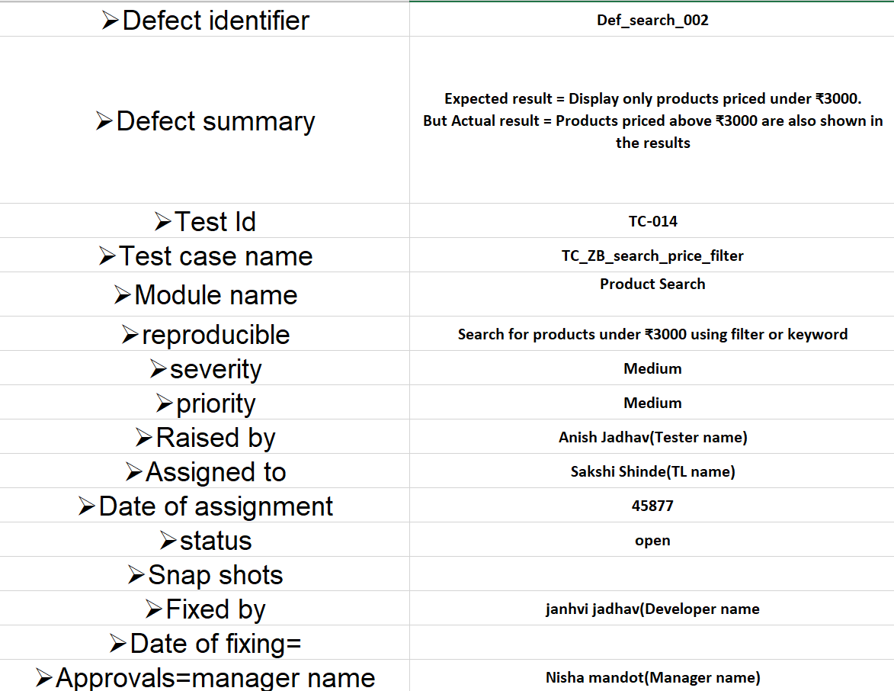

Slide 10
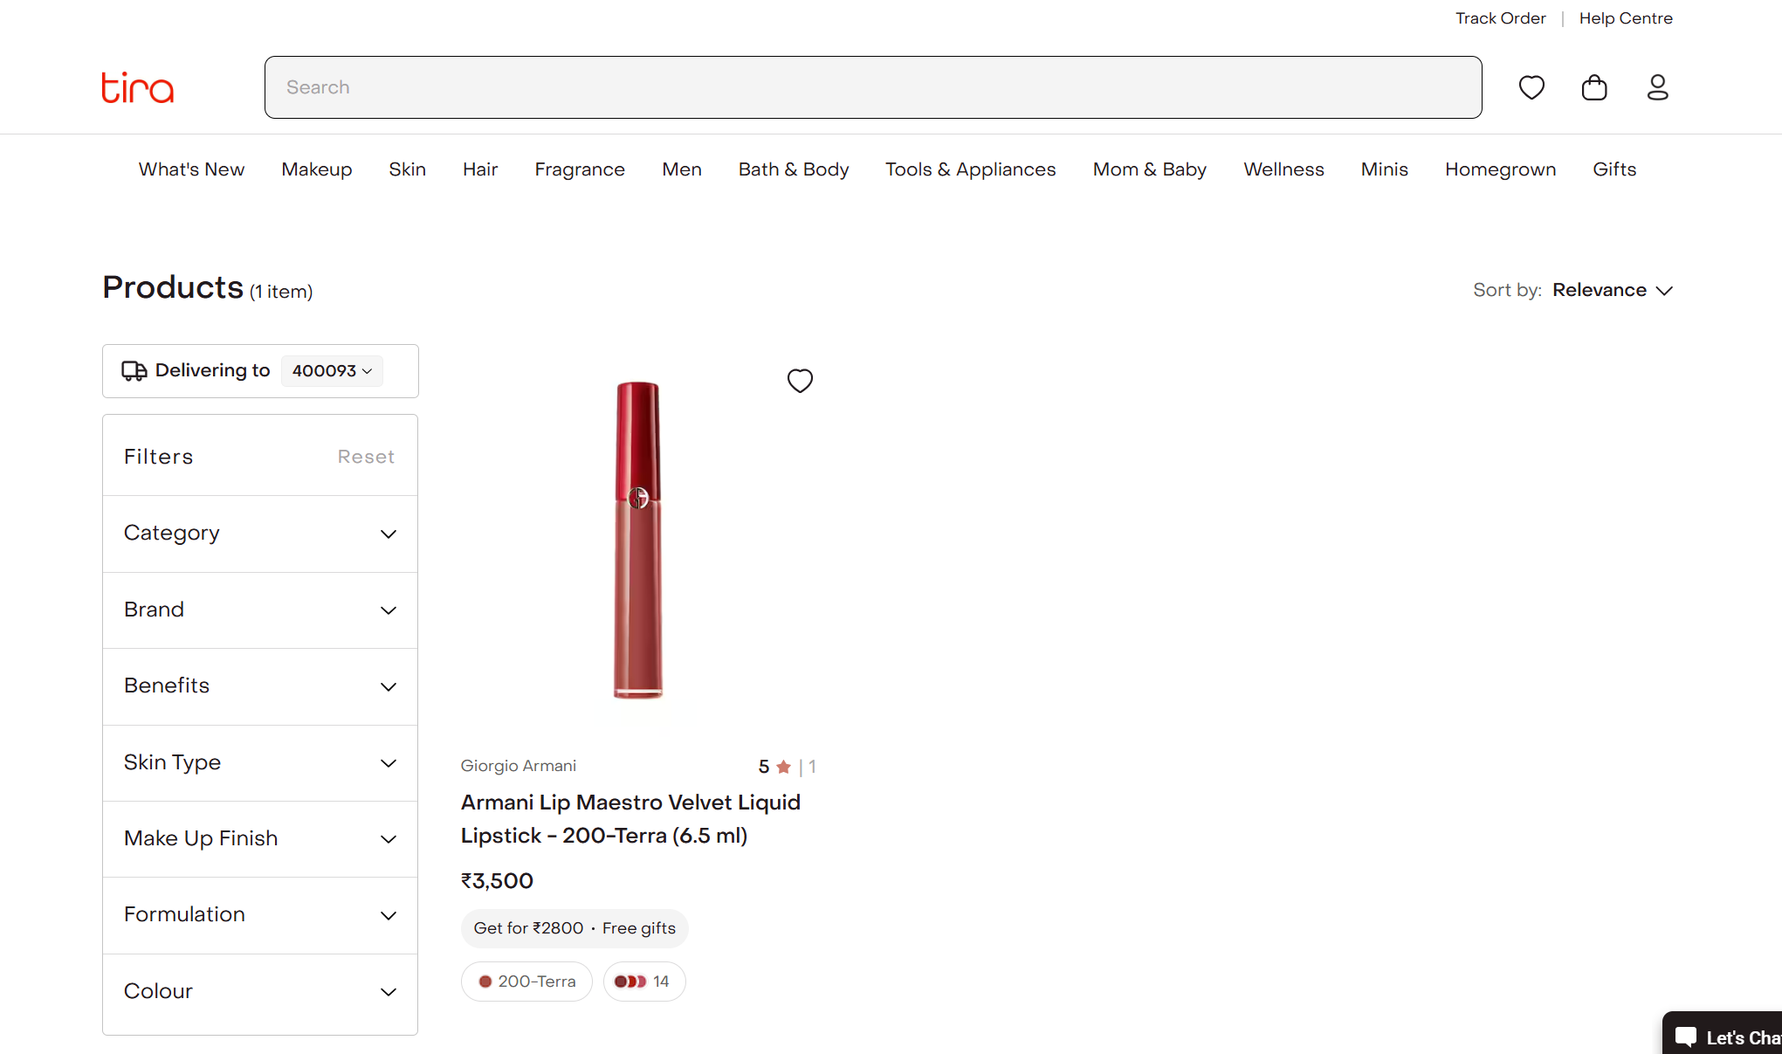

Slide 11
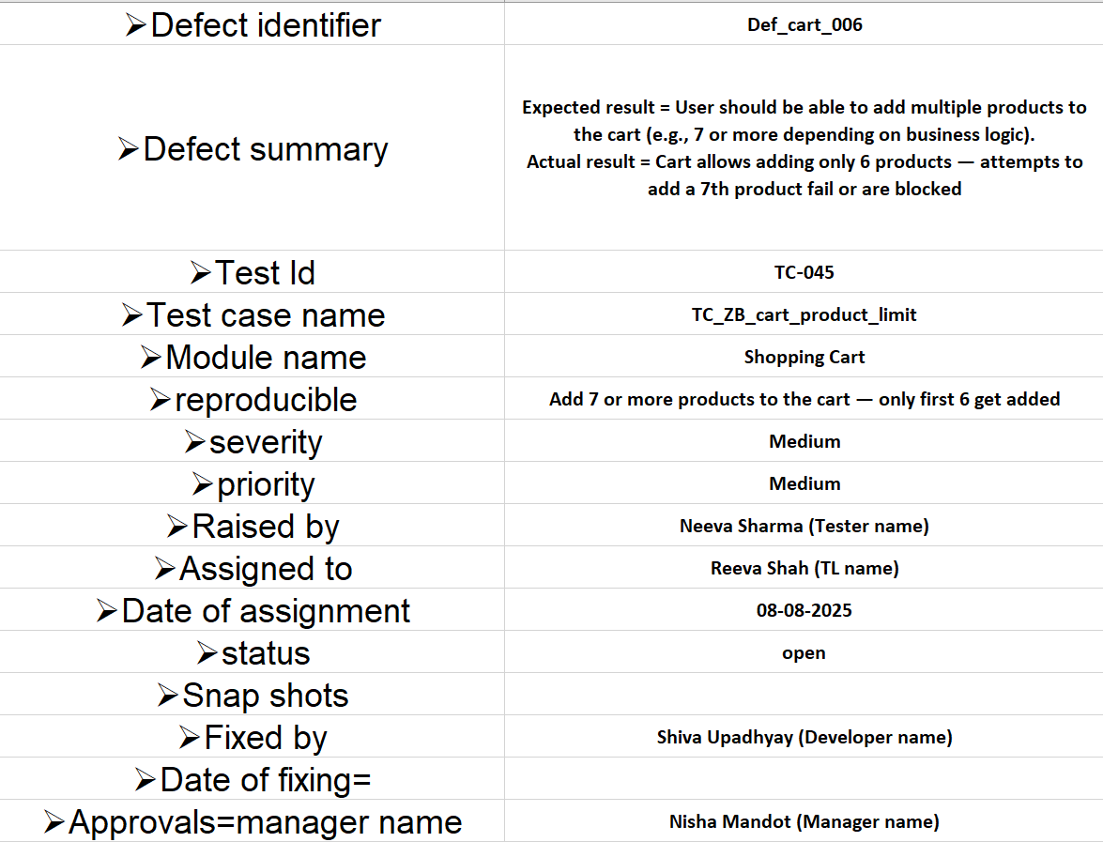

Slide 12
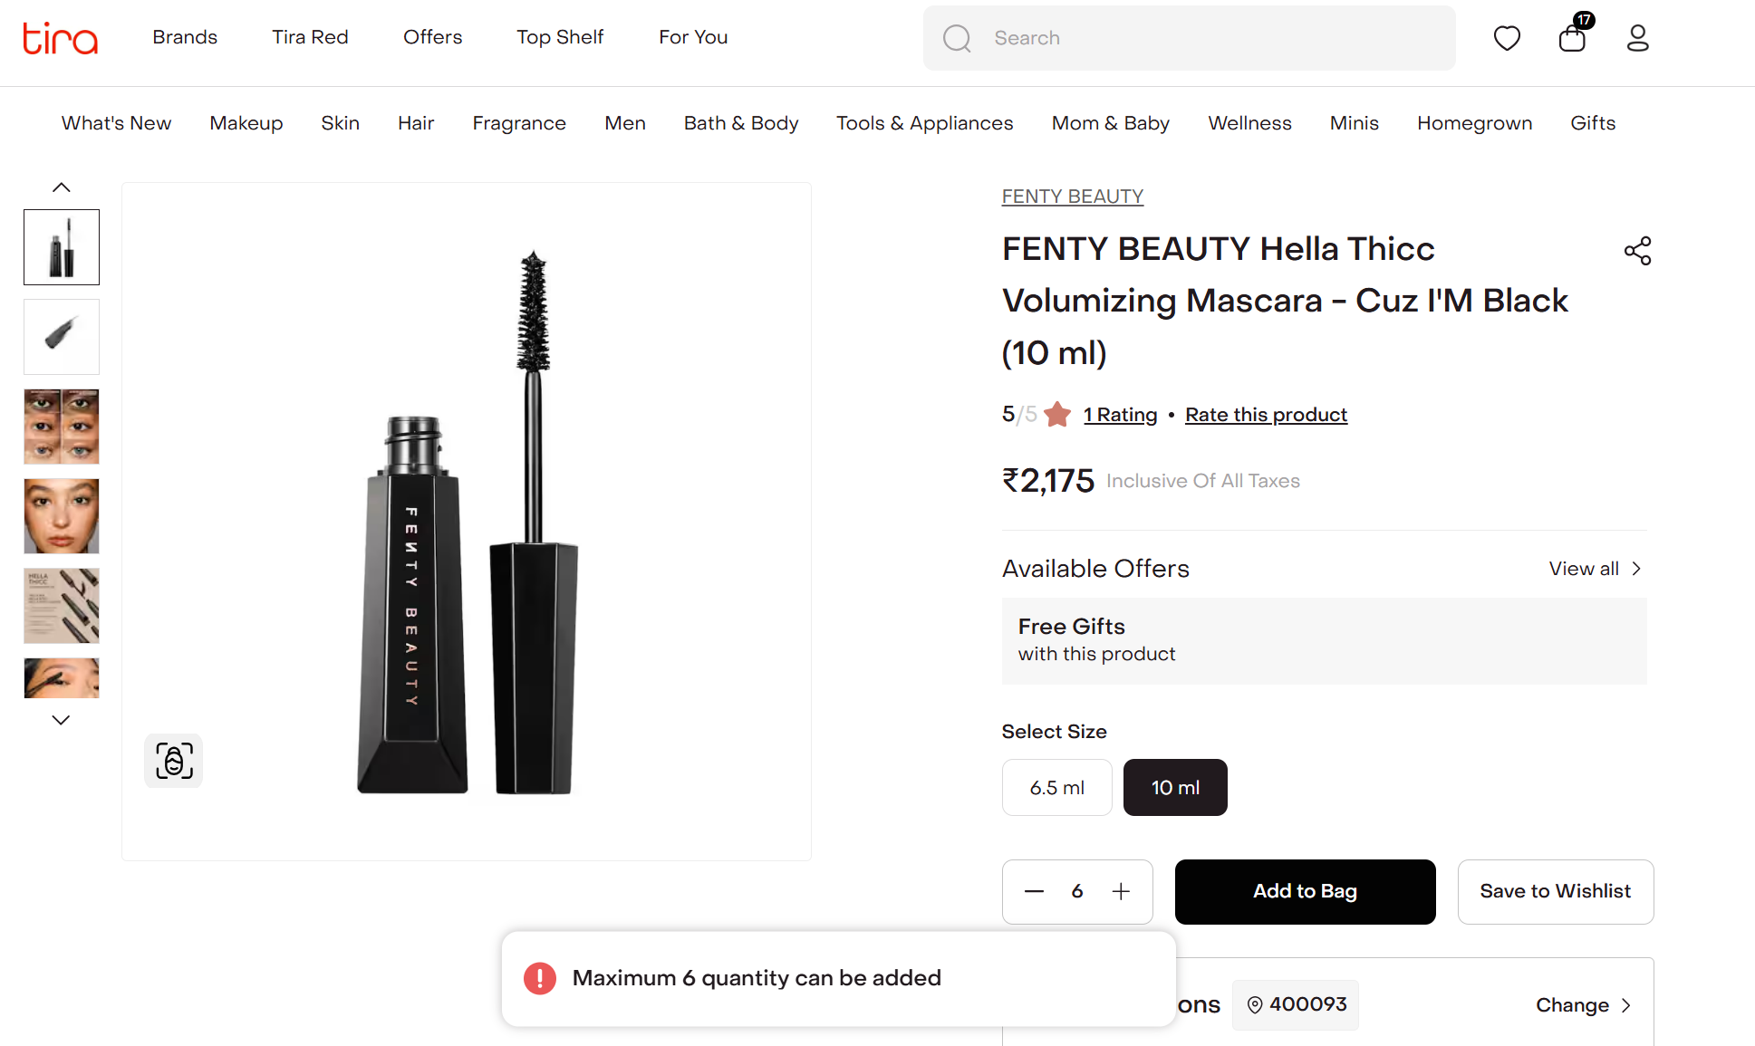

Slide 13
Challenges
Since Tira Beauty uses mobile number-based login with OTP, testers are required to enter a new OTP each time they log in, which slows down the testing process and makes it harder to automate.
Maintaining and resetting clean test data across multiple modules (cart, wishlist, login) was time-consuming and sometimes inconsistent.
Some features worked perfectly on Chrome but failed or behaved differently on Firefox or Safari, leading to additional cross-browser testing efforts.

Slide 14
Experience
I was able to identify bugs efficiently by thoroughly analyzing the functionalities.
Managing individual modules improved my time management and testing accuracy.
Continuous exploration of the application helped me write detailed and effective test cases.
Manual testing enhanced my observation skills and taught me to consider all possible user scenarios.

